Slide 1

Inventory Analysis Project
Ramsha Ali Khan June 2025

Slide 2


Project Overview
Objective
Analyze inventory data to fix stockouts, reduce excess inventory, and lower carrying costs
Outcome
Built a data-driven strategy using demand trends, EOQ, ROP, and turnover insights.

Slide 3
Datasets Used
Dataset | What It Contains
Sales | Sales quantity, price, and date
Purchases | Order quantities, PO and receiving dates
Beginning & Ending Inventory | On-hand inventory values
Invoices | Freight & invoice details
Purchase Price | Cost & classification (Alcohol or Wine)

Slide 4
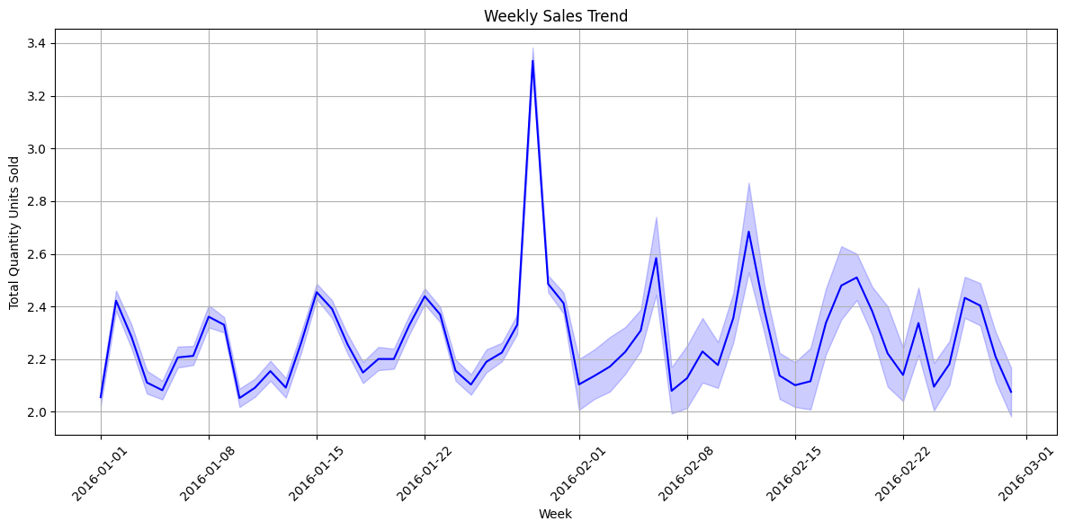
Sales Trend Analysis
There was high volume in sales in the last week of January.
February performed well overall month, however there was high fluctuation seen similar to Jan which end going down as the month finished

Slide 5
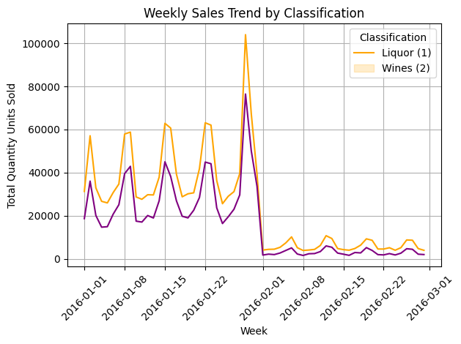
Weekly Sales Trend by Classification (considering 1 as Liquor and 2 as Wine)
Weekly sales analysis showed Liquor drives the bulk of store sales, particularly during January peaks. Inventory planning should prioritize liquor replenishment cycles and account for post-January drop-offs in both Liquor and Wine
Liquor (Classification 1)
Has higher weekly sales than wine overall
Shows strong weekly spikes, especially leading up to the last week of January
Hits a massive peak in late Jan (~100,000 units!) — possibly related to New Year demand
Wines (Classification 2)
Also shows weekly spikes, but consistently lower than liquor
Peak is around 75,000 units in late Jan
Trend follows liquor — suggesting similar seasonal behavior, but less volume

Slide 6
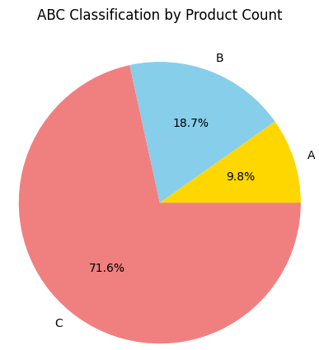
ABC Analysis – Inventory Classification
Objective
To categorize inventory items based on their impact on overall inventory value. This helps prioritize management attention toward the most critical items.
Insights
A-items, although few in number, make up the largest portion of inventory value and require tight control.
C-items, while many, contribute least to value but often have high sales volume — suggesting room to increase safety stock.
ABC classification helps the company focus its attention where it matters most — improving cost control and inventory efficiency
Recommendations
Review A-items monthly to avoid overstocking or stockouts.
Automate replenishment rules for C-items using demand patterns.
Re-run ABC analysis quarterly to reflect changes in price, volume, and demand

Slide 7
Compare ABC Category with Inventory On Hand
ABC Analysis combined with inventory levels shows a well-optimized stock distribution — A-class products, which contribute over 70% of revenue, are appropriately prioritized in inventory. C-class items are kept lean, reducing holding costs and minimizing excess.
Category | % of Total Inventory Value
A | 30.82%
B | 16.32%
C | 12.51%

Slide 8
Economic Order Quantity (EOQ) Analysis
By adopting EOQ-based ordering, the company can place smarter, cost-efficient orders based on real demand and holding costs — avoiding frequent small purchases (wasting money) or large stockpiles (increasing storage cost)
Top 10 Products to with high demand
Products | Annual Demand | Purchase Price | Holding Cost | EOQ
Smirnoff 80 Proof | 43423 | 0.77 | 0.077 | 18270.00725
Dr McGillicuddy's Mentholmnt | 24188 | 0.72 | 0.072 | 14101.2594
Yukon Jack | 24037 | 0.72 | 0.072 | 14057.17507
Smirnoff Raspberry Vodka | 22459 | 0.74 | 0.074 | 13403.0463
Skyy Vodka | 18586 | 0.72 | 0.072 | 12360.92263
Canadian Club | 19187 | 0.76 | 0.076 | 12224.21308
Capt Morgan Spiced Rum | 35866 | 1.47 | 0.147 | 12017.30198
Pinnacle Vodka | 15987 | 0.74 | 0.074 | 11308.15617
Jim Beam | 21239 | 1.07 | 0.107 | 10839.25201
Bacardi Superior Rum | 17861 | 0.93 | 0.093 | 10661.92396

Slide 9
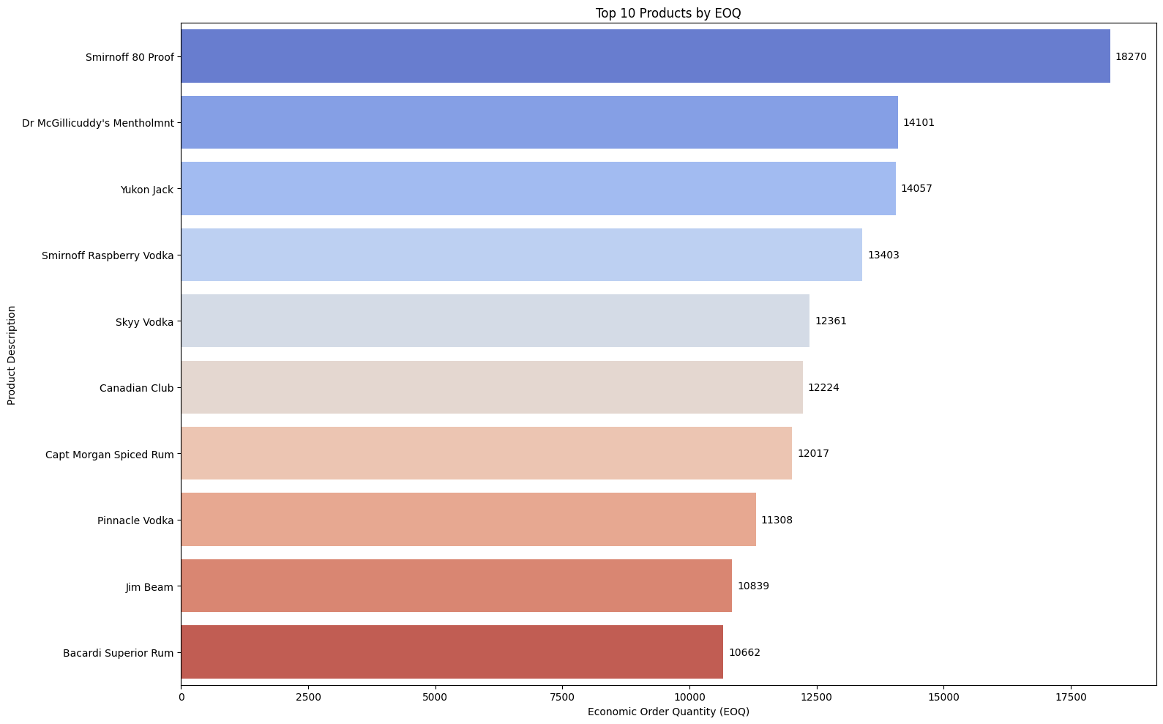
Economic Order Quantity (EOQ) Analysis
Observations
Smirnoff 80 Proof has the highest EOQ
Because it has the highest demand (43K units/year)
This means: order it in large batches, less frequently.
Items with higher purchase price (e.g., Capt Morgan) tend to have slightly smaller EOQs, assuming same demand, because higher prices → higher holding costs → EOQ goes down (since storing them is costlier)
Top 3 Products take bulk of inventory value are Smirnoff, Dr McGillicuddy, Yukon Jack = likely the ‘A’ items in ABC Analysis

Slide 10
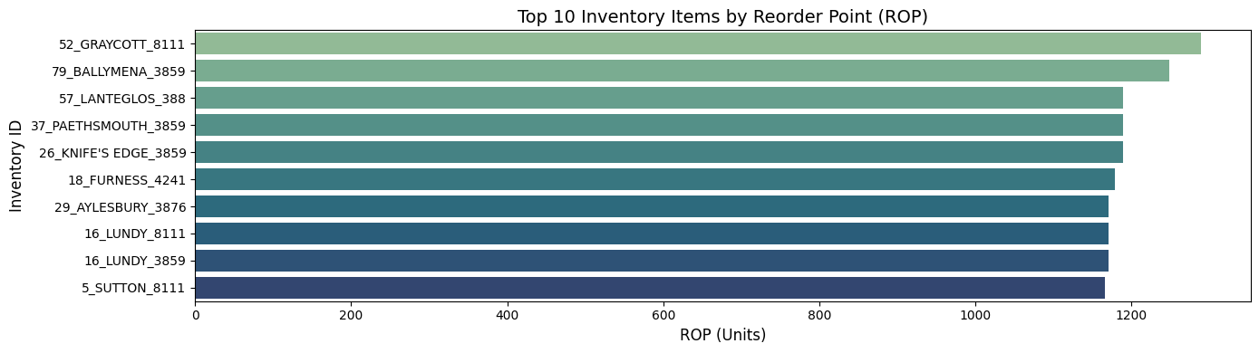
Reorder Point (ROP)
This tell us When should we reorder a product so we don't run out before the next batch arrives?
ROP values were calculated to ensure timely reordering before stockouts occur, based on historical lead times and daily sales velocity. Products with high lead times or rapid sales cycles require earlier reorders.
Top 10 Inventory Items by Reorder Point (ROP)

Slide 11
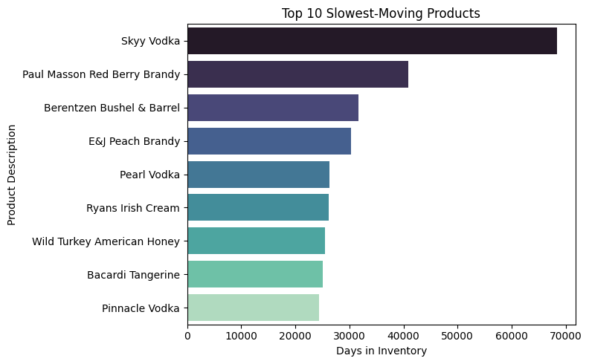

Inventory Turnover & Carrying Cost Efficiency
How efficiently are we using inventory, and where are we bleeding carrying cost?
Slow movers: Costly to hold, need attention
Fast movers: Move quickly, low Days in Inventory

Slide 12
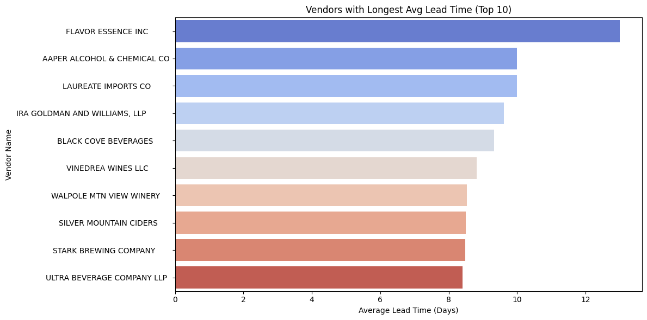
Identify Bottlenecks & Recommend Process Improvements
These vendors create procurement bottlenecks. Explore alternatives, reduce dependency, or renegotiate terms
Observations
Average vendor lead time ranged from 1 to 17 days
Longest average lead time: Vendor 45 with ~15.6 days
Majority of vendors delivered within 3–7 days

Slide 13
Inventory Management Strategy for Future Growth
 | Insight | Strategy
Demand-Driven Inventory Replenishment | You observed significant fluctuations in weekly demand | Implement demand forecasting models (like moving average or Prophet) to anticipate seasonality
 |  | Use forecasts to automate reorder triggers
Classification-Based Stocking (ABC Analysis) | “A” items make up a large % of inventory value but some are slow movers. “C” items are fast-moving but low-value. | Review stocking levels: Reduce buffer stock for slow “A” items, increase it for fast “C” items.
 |  | Apply different inventory rules: stricter control for A, lenient for C.
Optimize EOQ & ROP Settings | EOQ calculated shows opportunity to reduce ordering frequency and cost. ROP too low for some high lead time items | Adjust ROP formula to include safety stock: ROP = (Avg Daily Demand × Lead Time) + Safety Stock
 |  | Recalculate EOQ quarterly to adapt to changing demand and price
Tackle Procurement Bottlenecks | Some vendors show high lead time (up to 14 days). High freight cost with a few vendors | Vendor benchmarking: Replace or renegotiate with high-lead-time vendors.
 |  | Implement vendor scorecards (lead time, cost, fill rate, etc.)
Improve Inventory Turnover | Inventory turnover low for many SKUs. High carrying cost from slow-moving goods. | Markdowns or promotions to move dead stock.
 |  | Monitor inventory turnover monthly as a KPI
Technology & Workflow Optimization | Delays in approval/payment process can slow procurement. | Digitize PO, receiving, and invoice systems.
 |  | Use an integrated ERP system to link sales → inventory → procurement.
Sustainability & Scalability | Current practices risk overstock or stockouts as company scales | Adopt a Just-in-Time strategy for selected items (where feasible).
 |  | Build a scalable inventory policy framework that updates thresholds automatically based on moving 3-month demand average

Slide 14
Conclusion & Key Takeaways
This inventory analysis provided a data-driven evaluation of inventory practices at XYZ Manufacturing Company, leveraging six detailed datasets including sales, purchases, inventory levels, and vendor performance. Through strategic techniques like ABC classification, Economic Order Quantity (EOQ), Reorder Point (ROP), inventory turnover analysis, and vendor lead time assessment, we successfully identified areas for operational improvement.
Key findings revealed a high concentration of inventory value among a small percentage of A-class products, significant variance in item movement speeds, and critical procurement bottlenecks caused by vendors with long lead times. Products with slow turnover were found to contribute disproportionately to carrying costs, while fast-moving items risked stockouts due to late reorder triggers and vendor delays.
By incorporating calculated reorder points and EOQ thresholds, and prioritizing fast-moving, high-value items, the company can improve both cost efficiency and product availability. The vendor lead time analysis highlighted the importance of supplier performance in inventory strategy and underscored the need for vendor diversification or negotiation.
Overall, this analysis lays the foundation for a smarter, more responsive inventory management system that minimizes excess stock, prevents shortages, and enhances working capital utilization.

